Slide 1
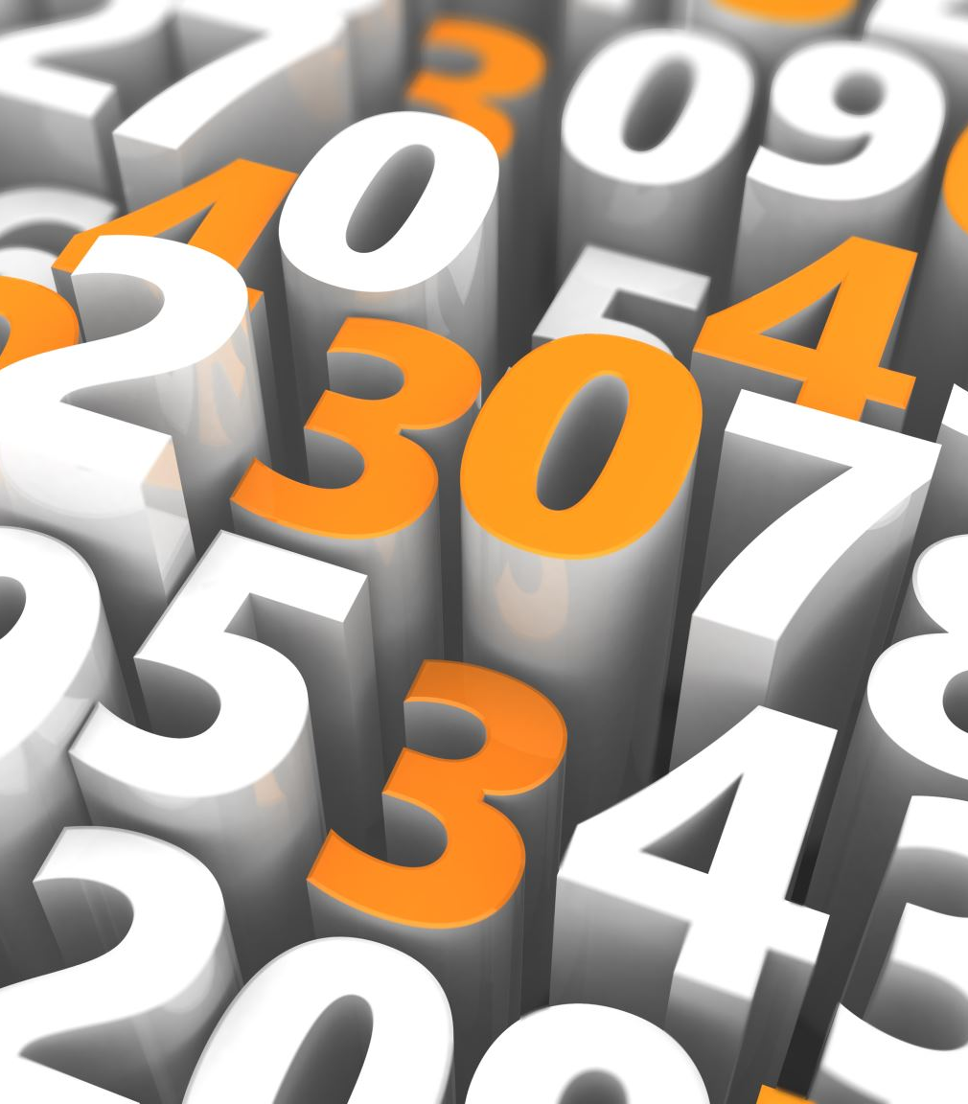
CS 210 PRESENTATION
Bilgehan İncedayı 29056

Slide 2
Introduction
Resource: Spotify
Current Data
Future Prediction based on Current Data for six months (Comparisons in Features)
My hypothesis: Seasonal events change do not significantly affect taste in music.

Slide 3
Features
Valence: A measure from 0.0 to 1.0 describing the musical positiveness conveyed by a track. Tracks with high valence sound more positive (e.g. happy), while tracks with low valence sound more negative (e.g. sad, depressed, angry).
Speechiness: It detects the presence of spoken words in a track. The more exclusively speech-like the recording (e.g. talk show, audio book, poetry), the closer to 1.0 the attribute value. Values above 0.66 describe tracks that are probably made entirely of spoken words. Values between 0.33 and 0.66 describe tracks that may contain both music and speech, either in sections or layered, including such cases as rap music. Values below 0.33 most likely represent music and other non-speech-like tracks.
Tempo: The overall estimated tempo of a track in beats per minute (BPM). In musical terminology, tempo is the speed or pace of a given piece and derives directly from the average beat duration.
Liveness: Detects the presence of an audience in the recording. Higher liveness values represent an increased probability that the track was performed live. A value above 0.8 provides strong likelihood that the track is live.
Loudness: The overall loudness of a track in decibels (dB). Loudness values are averaged across the entire track and are useful for comparing relative loudness of tracks. Loudness is the quality of a sound that is the primary psychological correlate of physical strength (amplitude). Values typically range between -60 and 0 db.
Acousticness: A confidence measure from 0.0 to 1.0 of whether the track is acoustic. 1.0 represents high confidence the track is acoustic.
Danceability: It describes how suitable a track is for dancing based on a combination of musical elements including tempo, rhythm stability, beat strength, and overall regularity. A value of 0.0 is least danceable and 1.0 is most danceable.
Energy: It is a measure from 0.0 to 1.0 and represents a perceptual measure of intensity and activity. Typically, energetic tracks feel fast, loud, and noisy. For example, death metal has high energy, while a Bach prelude scores low on the scale. Perceptual features contributing to this attribute include dynamic range, perceived loudness, timbre, onset rate, and general entropy.
Instrumentalness: Predicts whether a track contains no vocals. "Ooh" and "aah" sounds are treated as instrumental in this context. Rap or spoken word tracks are clearly "vocal". The closer the instrumentalness value is to 1.0, the greater likelihood the track contains no vocal content. Values above 0.5 are intended to represent instrumental tracks, but confidence is higher as the value approaches 1.0.

Slide 4
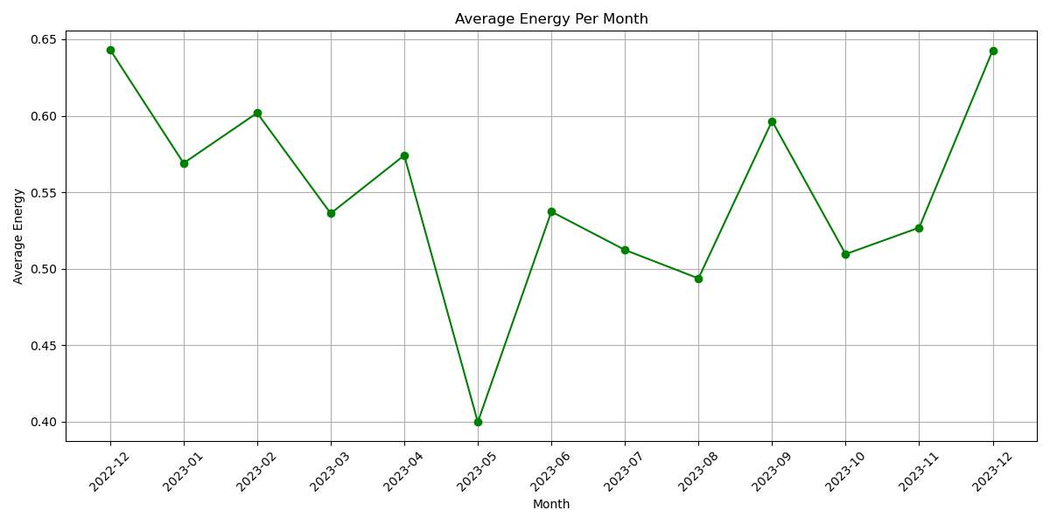
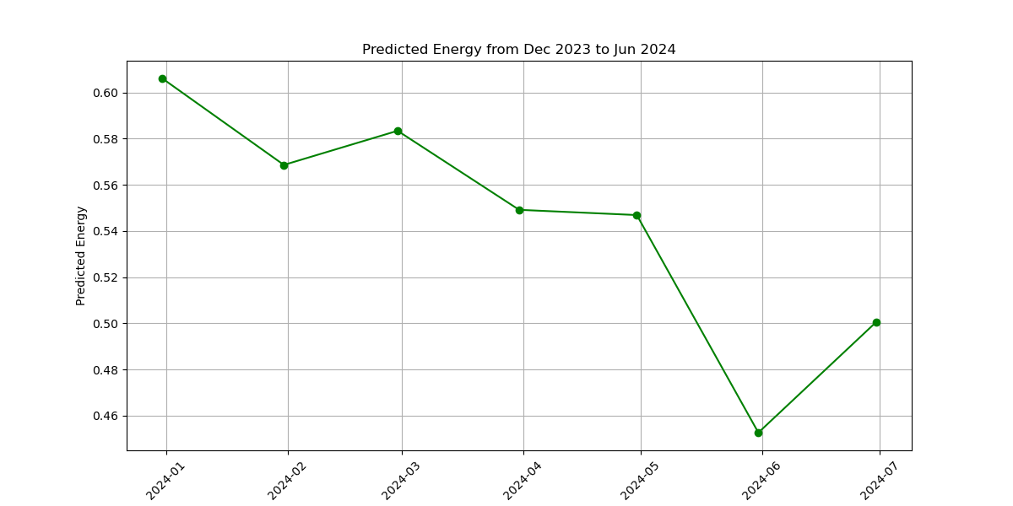
Energy
Current Data – Future Prediction (6 months)
Test Error: 0.0013477340865343326

Slide 5
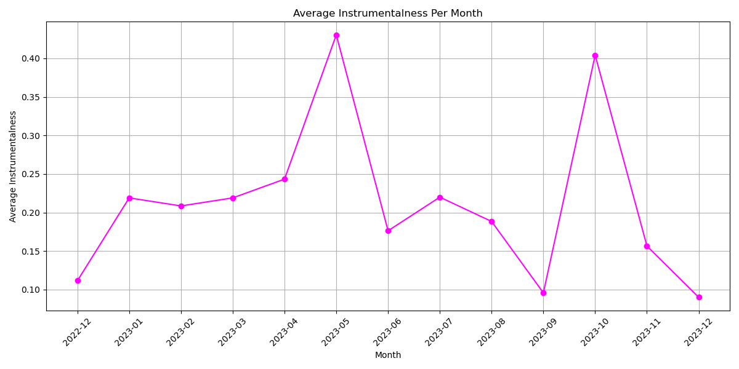
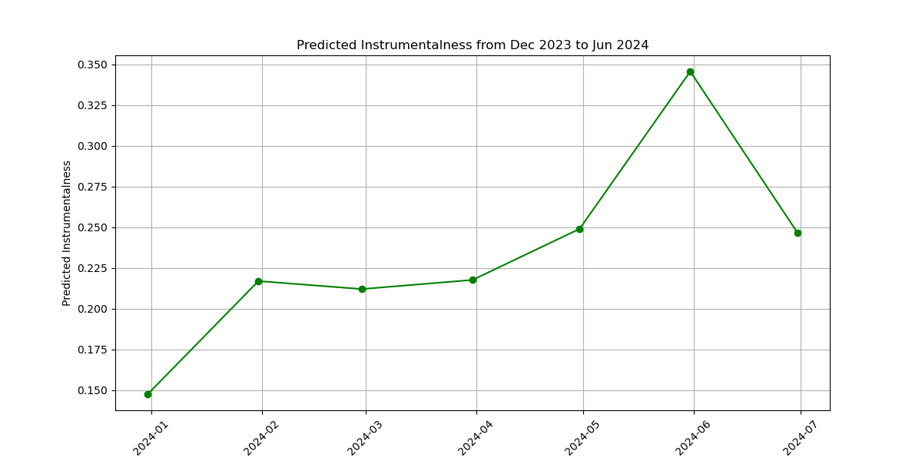
Instrumental
Current Data – Future Prediction (6 months)
Test Error: 0.003291145250270862

Slide 6
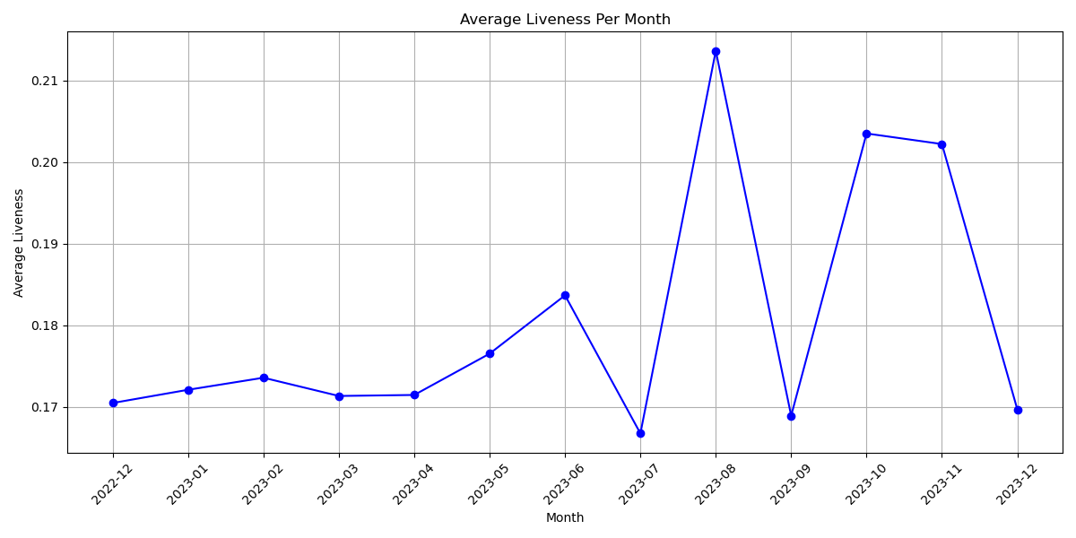
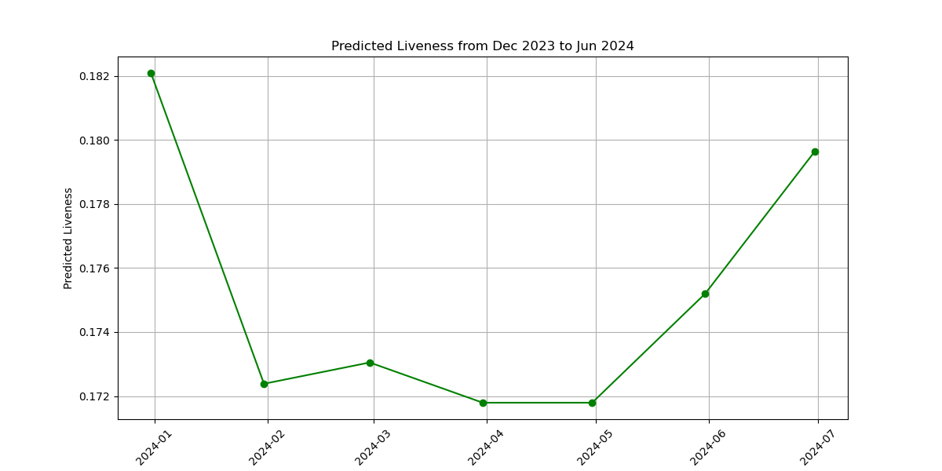
Liveness
Current Data – Future Prediction (6 months)
Test Error: 0.00015407465897967254

Slide 7
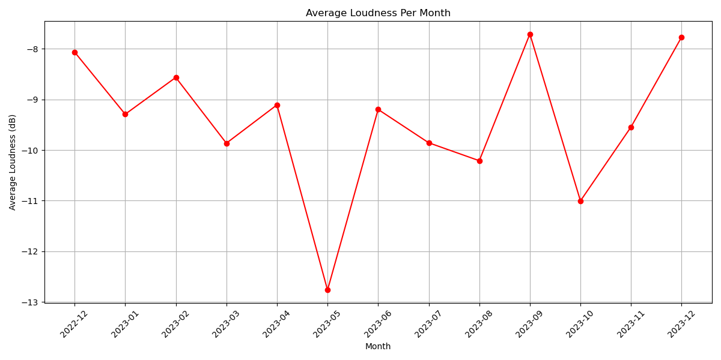
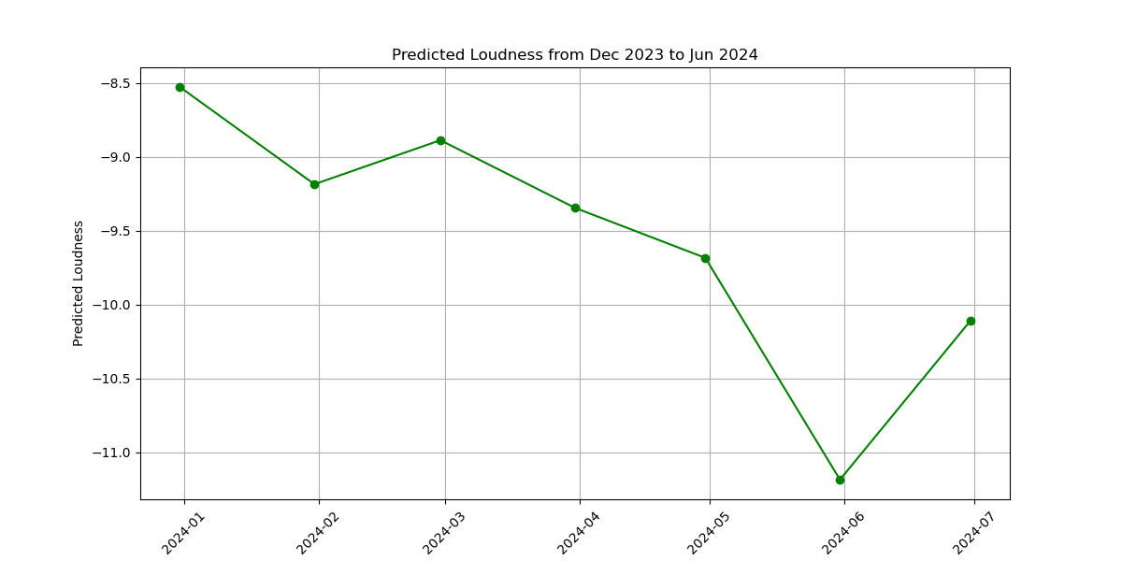
Loudness
Current Data – Future Prediction (6 months)
Test Error: 0.5812037809784598

Slide 8
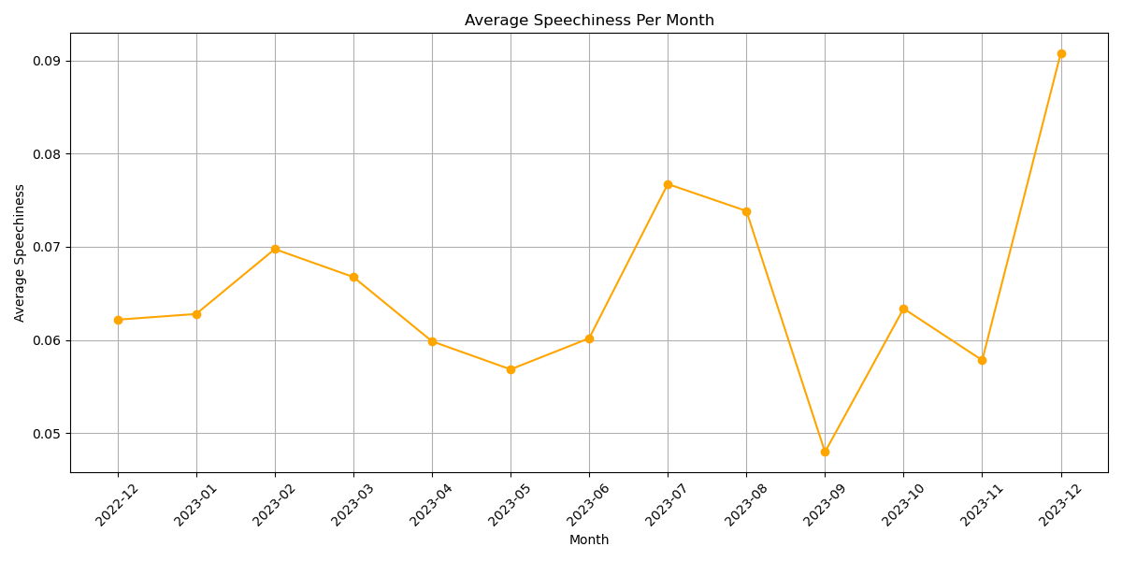
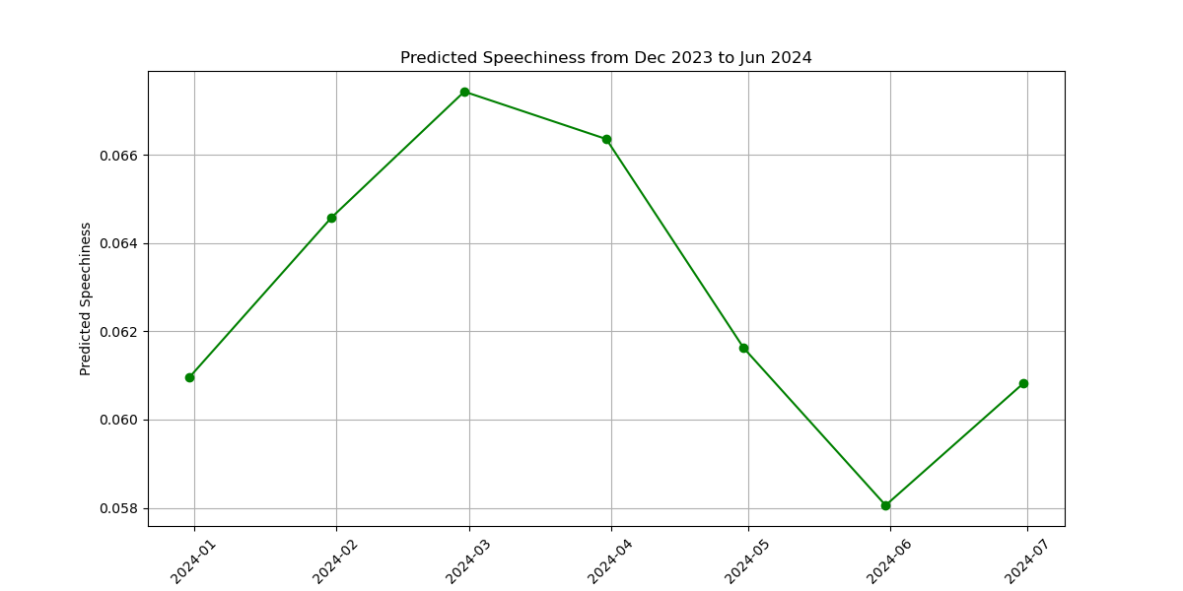
Speechiness
Current Data – Future Prediction (6 months)
Test Error: 0.0008896631367768656

Slide 9

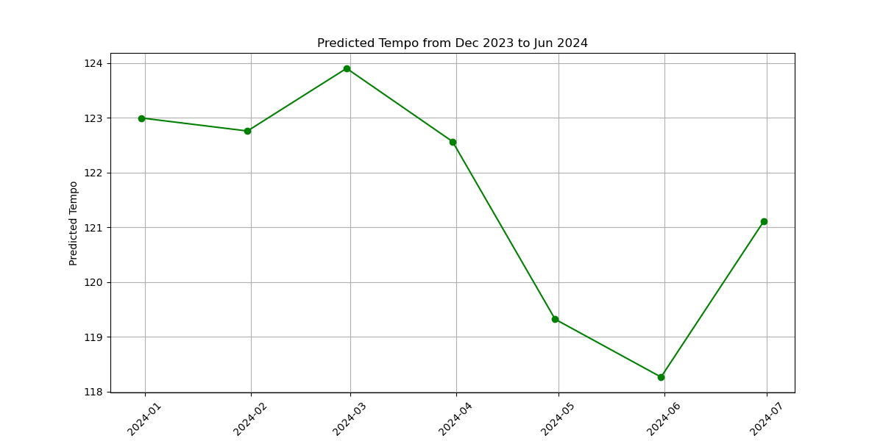
Tempo
Current Data – Future Prediction (6 months)
Test Error: 2.2496384538488994

Slide 10
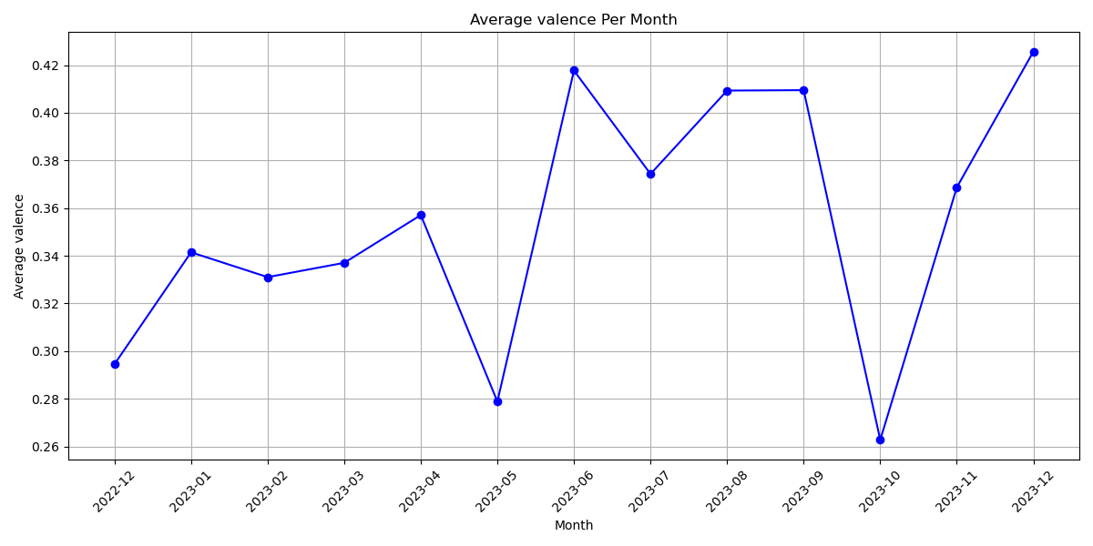
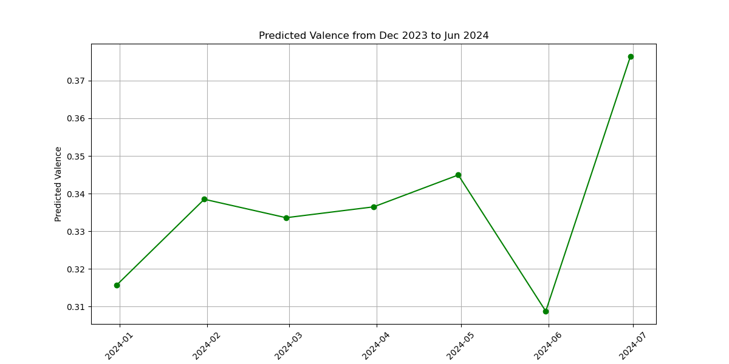
Valence
Current Data – Future Prediction (6 months)
Test Error: 0.01208496345508738

Slide 11
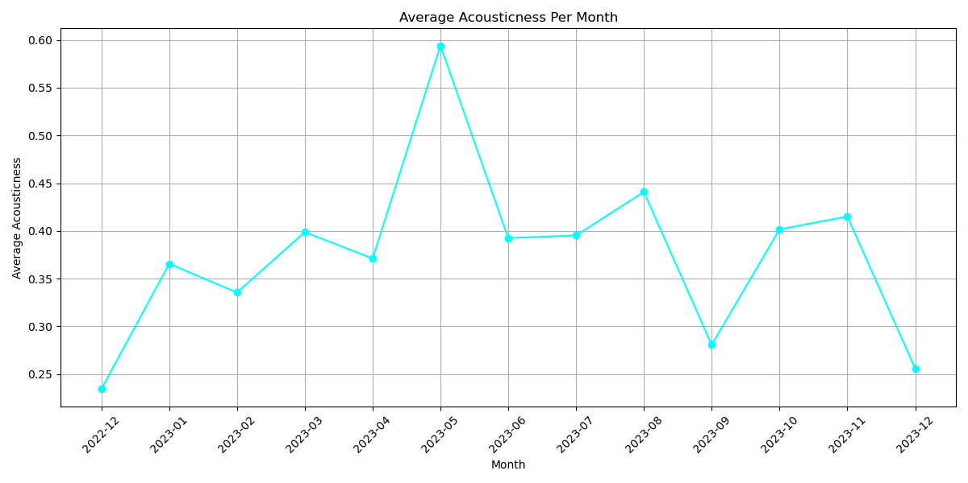
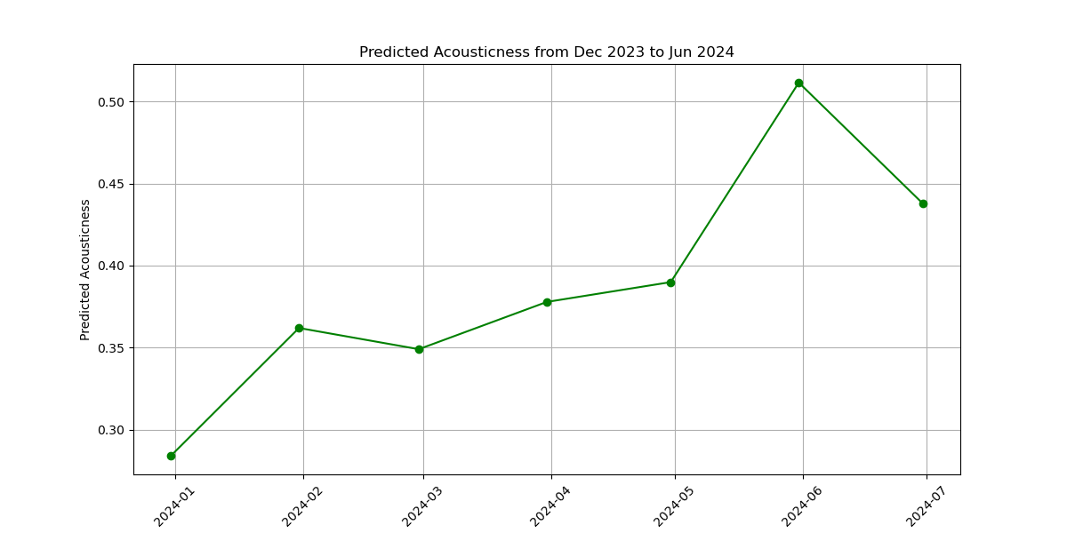
Accoustic
Current Data – Future Prediction (6 months)
Test Error: 0.0007936406960531068

Slide 12
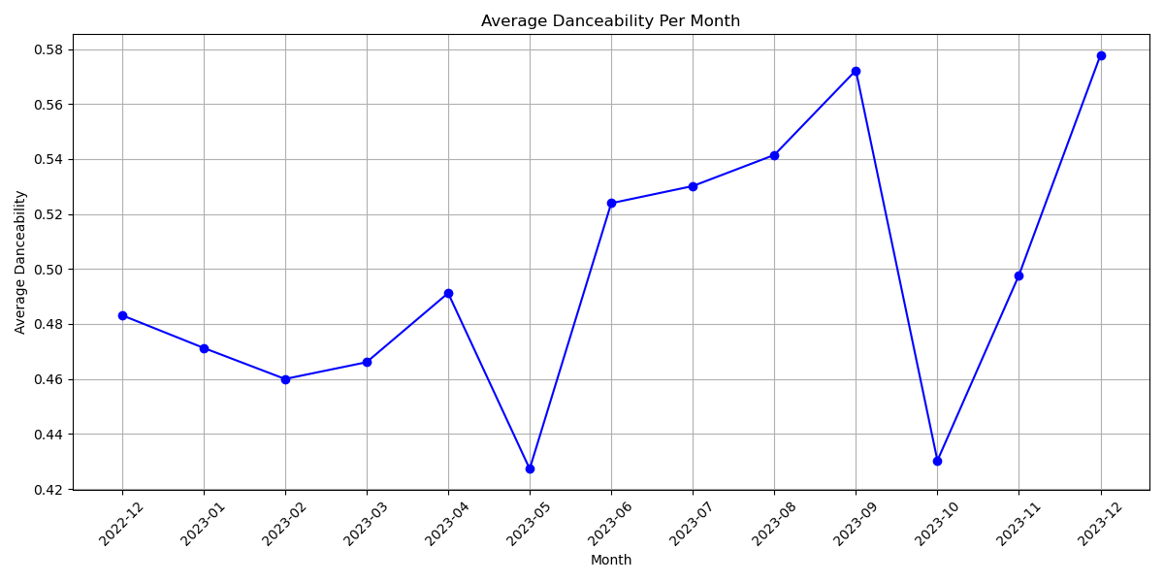
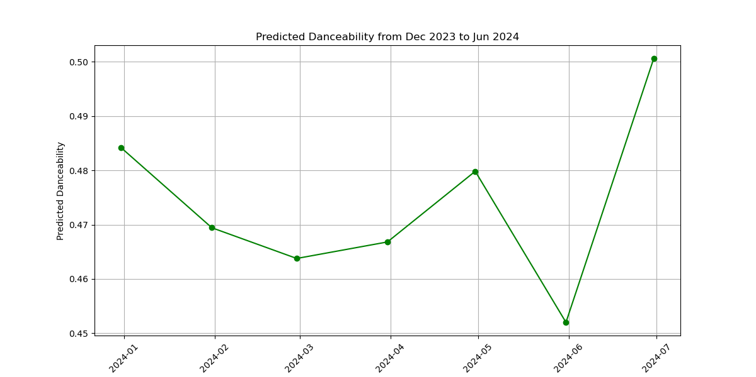
Danceability
Current Data – Future Prediction (6 months)
Test Error: 0.008770578799467662

Slide 13
Result of Hypothesis

